Slide 1

Welcome to the ESO Call!
10am -11am CT
First Wednesday of Each Month

Slide 2
November ESO Call Agenda
I. Welcome
II. New Member Introductions
Please introduce yourself and let us know how we can connect with you.
III. Entrepreneurial Spotlight
Kylie McClanahan, Chief Technology Officer, Bastazo Inc.
IV. Community Announcements

Slide 3





Considerations
We begin promptly at
10am CT on the ﬁrst Wednesday of each month. Calls are limited to one hour.
Meetings are recorded and will be made available upon request.
Please mute your microphones unless speaking.
If you have an announcement, please make sure you send it in our announcement link on our website.

Slide 4

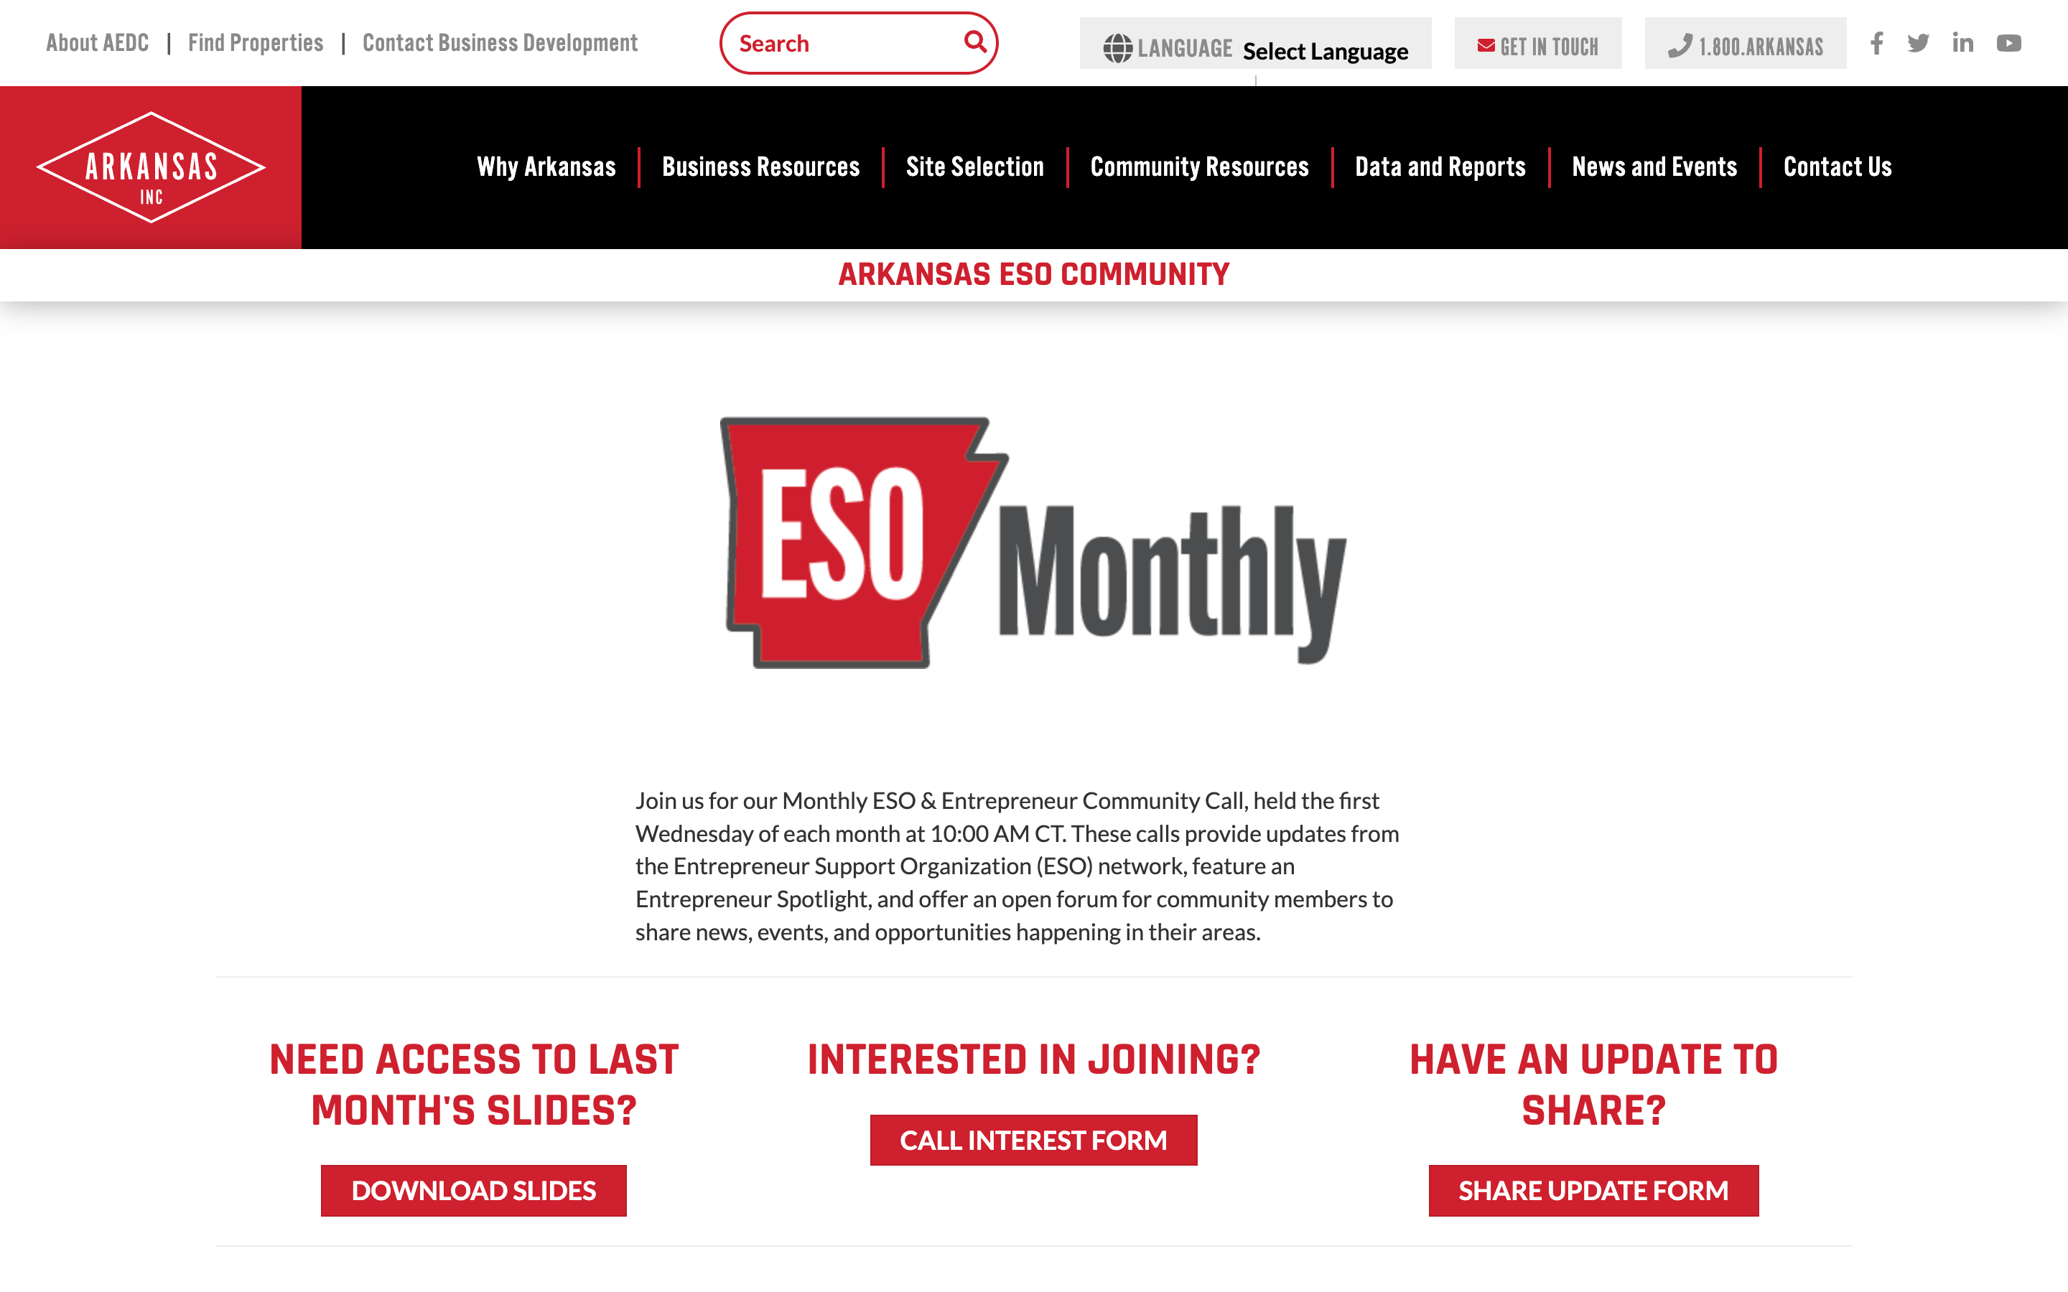

ESO Call Landing Page
A central location where you can find important links such as the call’s joining link, community updates, the previous ESO slide deck, and more.
bit.ly/AR-ESO
If you have questions or concerns, please contact:
Mallory Race, Senior Project Manager
Arkansas Economic Development Commission
Mallory.Race@ArkansasEDC.com

Slide 5
New Member Introductions

Slide 6

ESO Monthly:
November 2025
Kylie@Bastazo.com

Slide 7

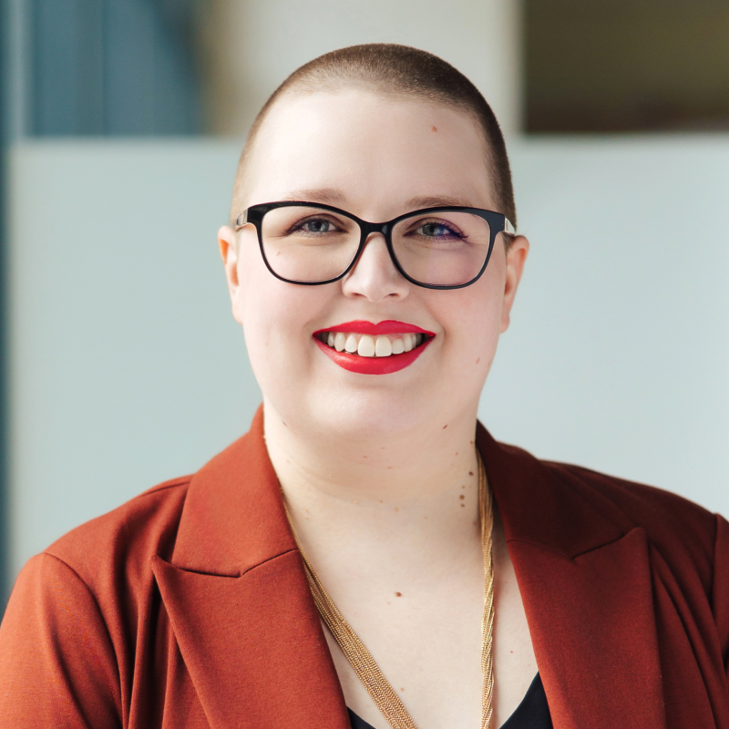
Who We Are
Kylie McClanahan
Ph.D, CTO at Bastazo
Kylie McClanahan, Chief Technology Officer (CTO) at Bastazo, is a forward-thinking leader with expertise in cybersecurity and critical infrastructure. With nearly a decade of experience in the electric utility sector and has her PhD in Computer Science, Kylie plays a pivotal role in advancing cybersecurity solutions for operational technology. At Bastazo, she focuses on leading the technology teams to develop Bastazo’s platform to address vulnerabilities, ensuring the resilience and safety of critical infrastructure. Kylie is passionate about protecting vital systems, advocating for practical solutions, and bridging the gap between research and real-world application. Kylie also holds a GCIP certification from GIAC, the only certification available for the NERC CIP standards.

Slide 8
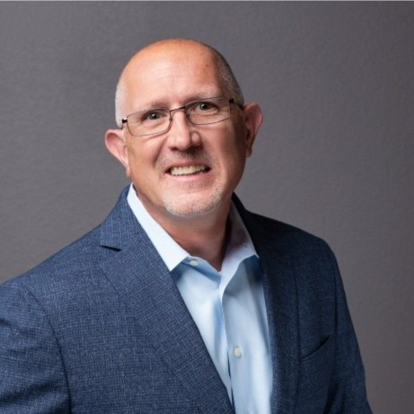
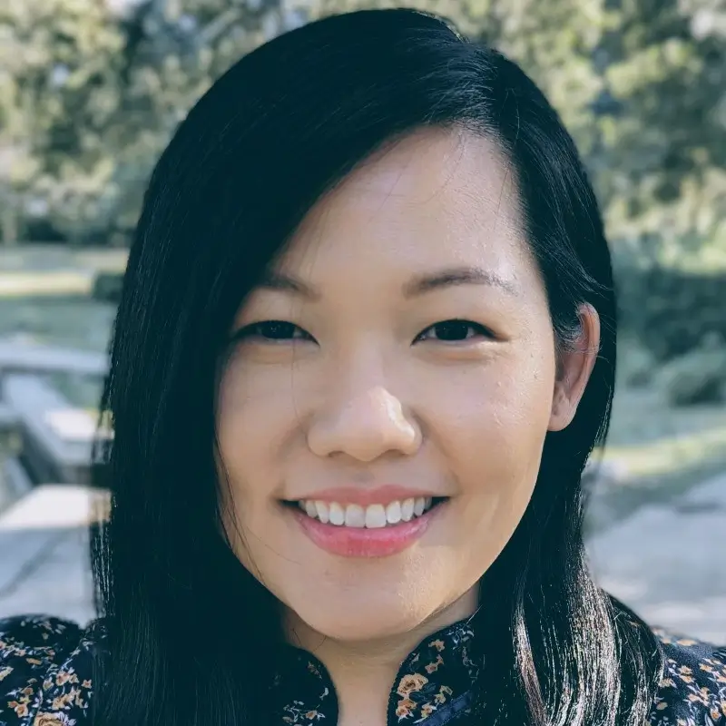
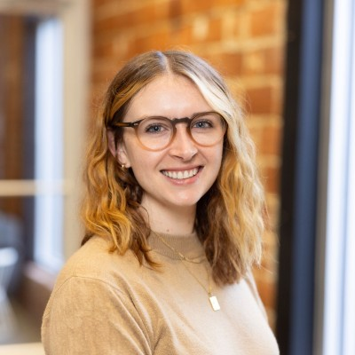
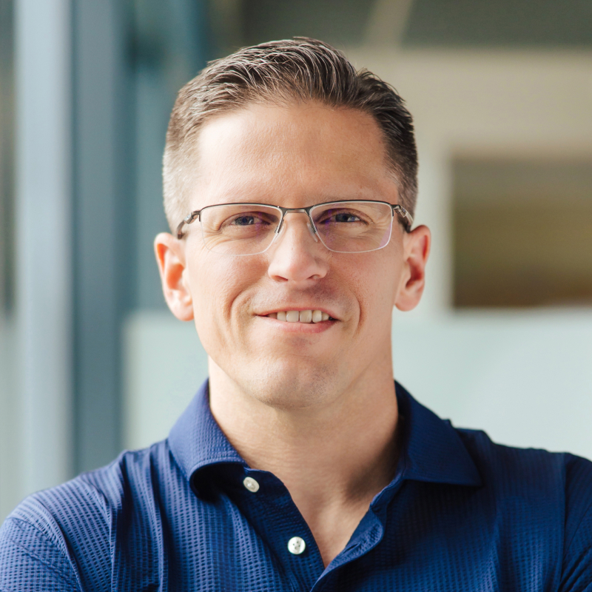
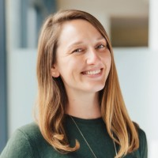
Our Team
Willi Nelson
CEO
Former Head of OT at GSK, former CISO at Fortinet; strategic advisor in OT space; mentor and industry expert
Thao Le-Vasicek
VP of Operations
Manages finances, human resources, and legal matters
Kylie McClanahan
Ph.D, CTO
Frequent speaker at OT cybersecurity conferences across the globe
Rebecca Black
Marketing Contractor
Local expert; focus on branding, marketing strategy, and content creation
Philip Huff
Ph.D., Chief Scientist & Founder
Professor at University of Arkansas, serves on international committees to advance the resilience of critical systems
Danielle Chaney
Partner Channel Manager
Manages relationships and operations for all partnerships

Slide 9
The Story of Bastazo
Bastazo, meaning “to carry the burden,” was founded in 2020 by a group of professors at the University of Arkansas and the University of Arkansas at Little Rock, in partnership with the DoE.
Originally a research project, the work evolved to meet a critical industry need.
It has since been commercialized and expanded into a ten-person company whose Arkansas-rooted team helped shape the core of the Bastazo platform.
2020
Bastazo Founded by Alan Mantooth, Jia Di, Philip Huff, Qinghua Li
July 2023
Launched First Product
August 2023
$2.2 M BIRD Grant with Salvador Technologies
Summer 2024
Fuel
Accelerator
Fall 2024
HF0
Accelerator
February 2025
Official Bastazo Platform Launch
May 2025
Received Seed Funding from Cortado Ventures
Confidential – Do Not Share

Slide 10



The Problem
Our critical infrastructure is under attack.
You’ve seen the news: we are facing real threats in our grid.
Organizations are under- equipped to handle the onslaught of vulnerability alerts, and aging infrastructure makes fixes genuinely risky.
Confidential – Do Not Share

Slide 11

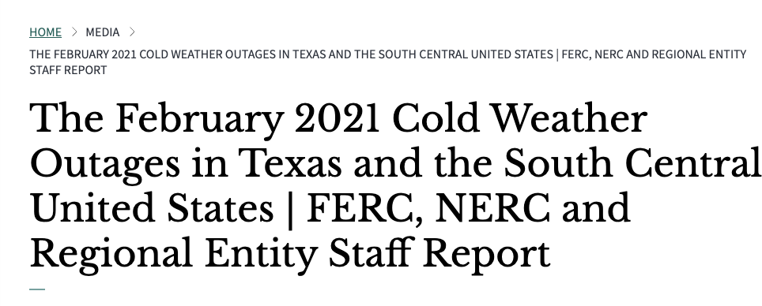
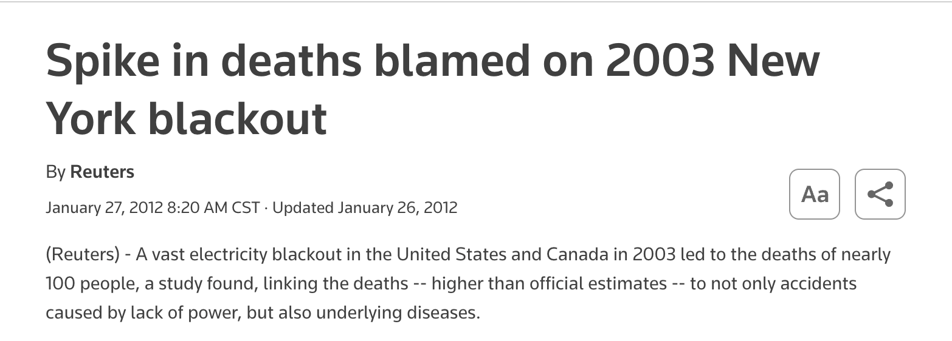
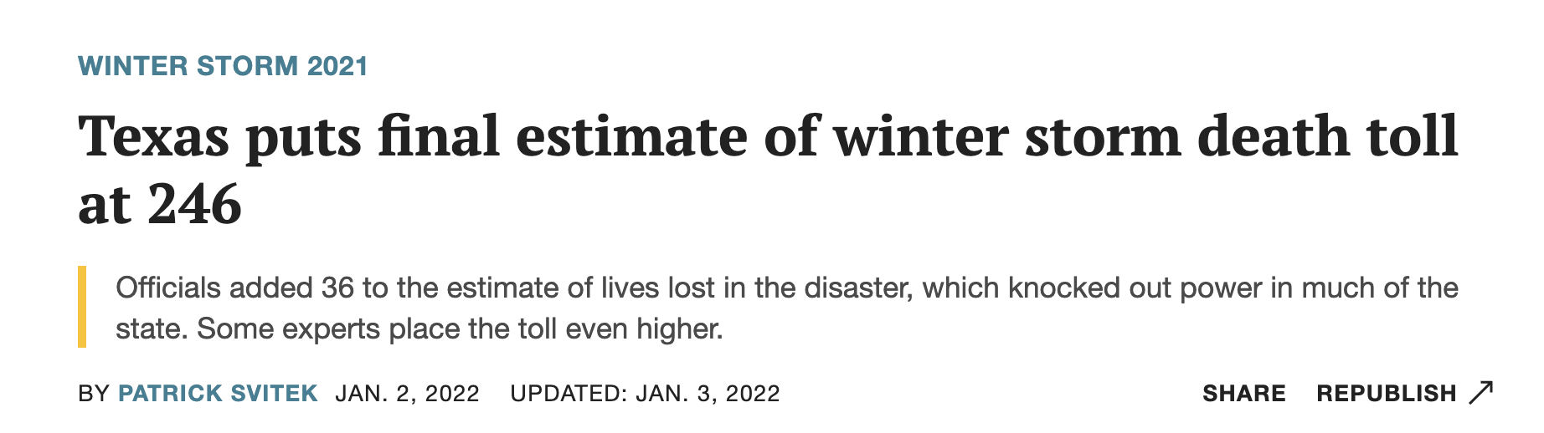
The Problem
What happens when our utilities go down?
People die.
Confidential – Do Not Share
Notes:
How many of you have experienced an unexpected blackout?

Slide 12
Rising Threats
1162
Cyberattacks on U.S. utility firms jumped nearly 70% between 2023 and 2024
Cyber actors affiliated with China, Russia, and Iran have already infiltrated utilities across the US.
689
2023
2024
Confidential – Do Not Share
Notes:
https://www.reuters.com/technology/cybersecurity/cyberattacks-us-utilities-surged-70-this-year-says-check-point-2024-09-11/
There were 1,162 cyberattacks on average through August this year, compared to 689 in 2023, Check Point data showed.
https://www.dni.gov/files/CTIIC/documents/products/Recent_Cyber_Attacks_on_US_Infrastructure_Underscore_Vulnerability_of_Critical_US_Systems-June2024.pdf

Slide 13
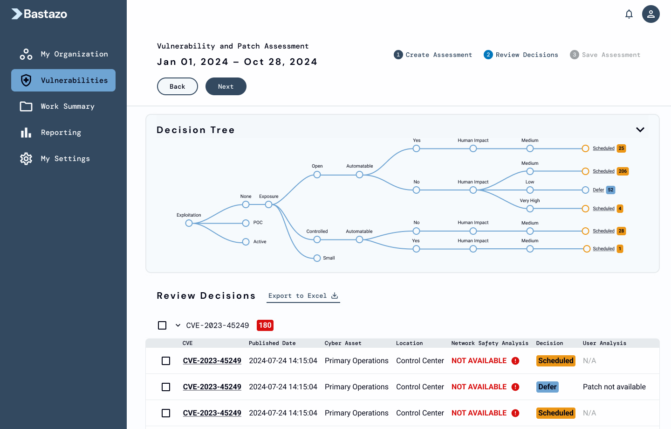
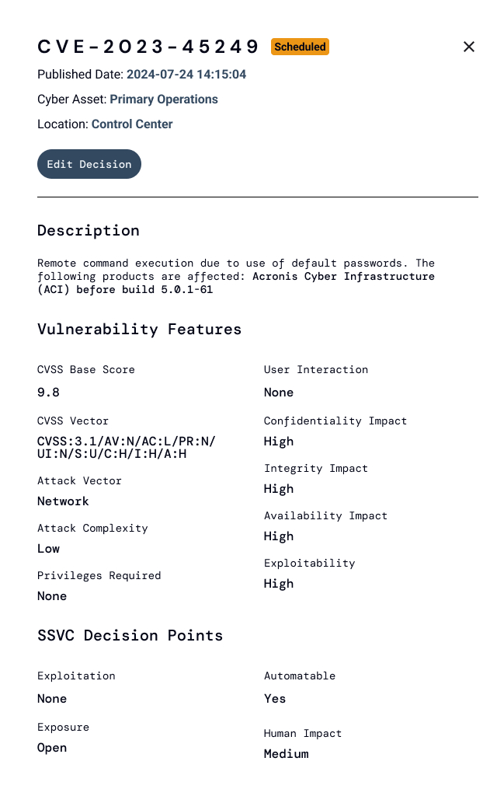
Our Solution
The Bastazo platform highlights exactly what teams need to focus on to reduce their risk to infrastructure.
Through extensive research funded by the DoE, the Bastazo team has built advanced technology that identifies, prioritizes, then offers remediation plans for critical vulnerabilities in OT environments.
Confidential – Do Not Share
Notes:
In order to move organizations to proactive action, we are solving the root problem of cybersecurity by providing AI-powered, prioritized remediation strategies unique to their networks.
The Bastazo platform highlights exactly what orgs need to focus on to reduce their infrastructure risk.
“Don’t nail the window shut when the front door is open.”
We help organizations focus on what needs to be done to reduce their risk, quickly.
Priority**

Slide 14



Our Technology
What takes a technical team weeks to do today, Bastazo does in seconds.
Our Solution:
Categorization of the top 5% of vulnerabilities based on an organization’s unique environment.
Real-time, custom view of the organization’s biggest threats.
Proprietary AI model matches critical vulnerabilities with the most effective remediation strategy.
Automated security reporting for strict compliance environments (e.g. NERC CIP)
Confidential – Do Not Share

Slide 15



Where We Are Today
Seed Round
$2.4 M
POC with Fortune 100 Company
Activated
Partner Channel
Industry Conferences
Local
Internships
Confidential – Do Not Share
Notes:
In order to move organizations to proactive action, we are solving the root problem of cybersecurity by providing AI-powered, prioritized remediation strategies unique to their networks.
The Bastazo platform highlights exactly what orgs need to focus on to reduce their infrastructure risk.
“Don’t nail the window shut when the front door is open.”
We help organizations focus on what needs to be done to reduce their risk, quickly.
Priority**

Slide 16
Call to Action to the ESO Community
Introductions
Partnerships: If there are other organizations you know of where Bastazo could complement their efforts…
Direct Customers: If you have connections with any utilities, manufacturers, oil & gas organizations who could benefit from our product…
Investors: If you have connections to investors interested in in funding tech startups…
Speaking Engagements
Kylie is on tech speaker rotations and always happy to speak, including at tech conferences, industry meetings, cybersecurity summits, etc.
Confidential – Do Not Share
Notes:
In order to move organizations to proactive action, we are solving the root problem of cybersecurity by providing AI-powered, prioritized remediation strategies unique to their networks.
The Bastazo platform highlights exactly what orgs need to focus on to reduce their infrastructure risk.
“Don’t nail the window shut when the front door is open.”
We help organizations focus on what needs to be done to reduce their risk, quickly.
Priority**

Slide 17
Questions?
Kylie McClanahan
CTO
kylie@bastazo.com
Bastazo.com
Confidential – Do Not Share

Slide 18


November 2025
Community
ANNOUNCEMENTS

Slide 19


Slide 20


Slide 21

January 22 - Fayetteville, AR
Connecting Innovation | Transforming Tomorrow

Slide 22
Thank you for joining us!
See you next month!
Next meeting will be held November 5th at 10 CT

